Slide 1

IT TICKET ANALYSIS
-Ritik Katiyar

Slide 2

Problem statement
To understand the performance of IT Agents.
To understand the efficiency of ticket resolution.
To understand the satisfaction levels of employees.

Slide 3

AIMS
To evaluate the performance among IT agents.
Assess the overall effectiveness of the team.
Identify the areas for improvement in the ticket resolution process.
To make informed staffing decisions, including hiring, firing, & training.
To enhance overall service quality and team performance.

Slide 4

Performance data
Total Agents – 50
Average age of IT Agents- 40 years
Total number of Tickets – 97,498
Average daily ticket volume – 53.36 (Total tickets/total unique days).
Average Resolution Time for tickets – 4.5 days

Slide 5
KPIs Overview
Total No. of Tickets (Ticket Volume)
No. of Agents
Avg. Resolution Time (Days) to Fix the Issue
Avg. Satisfaction Rate
Ticket Volume Over Time (Year)
Ticket Volume, Avg. Satisfaction Rate & Avg. Resolution Time by Age Group
Volume of Tickets by Severity (Priority-Based)
Avg. Resolution Time (Days) by Request Category (Severity-Based)
Peak & Off-Peak Months
Distribution of Tickets by Request Category

Slide 6
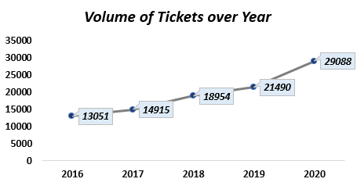
Volume of Tickets over Time(years)
Tickets volume has steadily increased over the years.
Spikes were noticed in 2018 and 2019, with the highest spike in 2020.
Volume of Tickets increases but number of agents has remained constant over the years, resulting in a higher workload.

Slide 7
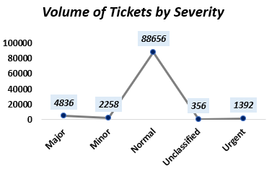
Distribution of Tickets by Severity
There is mis-match between severity & priority, as large number of Normal severity tickets remain unassigned.
Major, Minor, Urgent, and Unclassified tickets have the least unassigned volume.

Slide 8
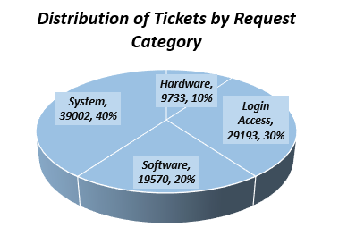
Volume of Tickets by Request Category
System and Login Access requests together account for nearly 75% of total ticket volume, indicating that most support demand is concentrated around system operations and access management.
System-related tickets represent the largest share(40%), followed by Login access(30%),Software(20%) and Hardware(10%).

Slide 9
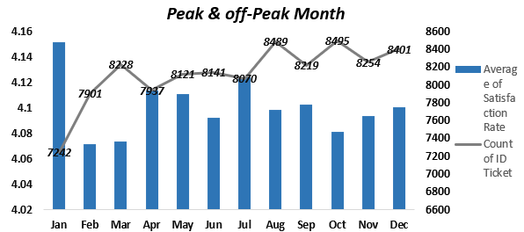
Peak & off-peak Months
Peak months with more than 8,400 tickets are August, October, and December, while off-peak months with less than 8,000 tickets are January, February, and April.
Agents have steadily improved the average satisfaction rate from 3.97 in 2016 to 4.16 in 2020.
Highest monthly satisfaction is recorded in January, July, and April, while lowest satisfaction is in June, despite good volume of tickets(8,141) tickets).

Slide 10


